Slide 1
Installation Guide
(Database – Oracle 10.2.0.1.0)
2009. 07. 21
CODELABOR
Shin Sang Jae (codelabor@gmail.com)

Slide 2
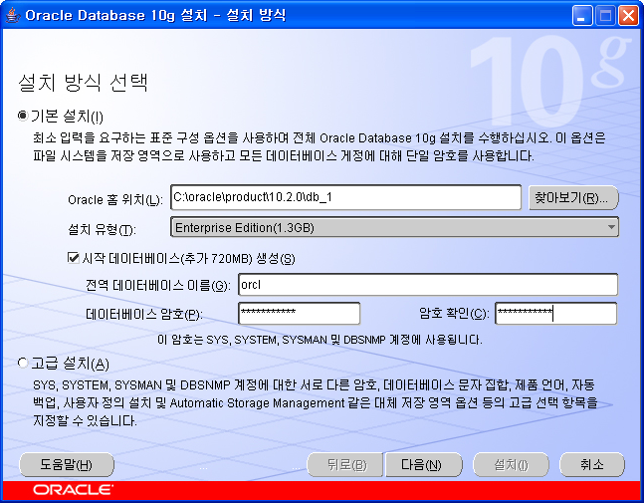

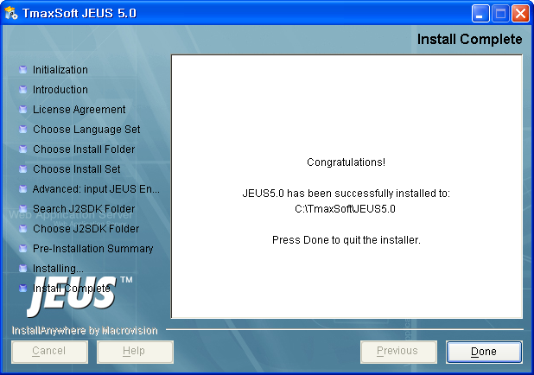
Oracle
Install
File: setup.exe
Oracle Home: C:\oracle\product\10.2.0\db_1
Global Database Name: orcl

Slide 3
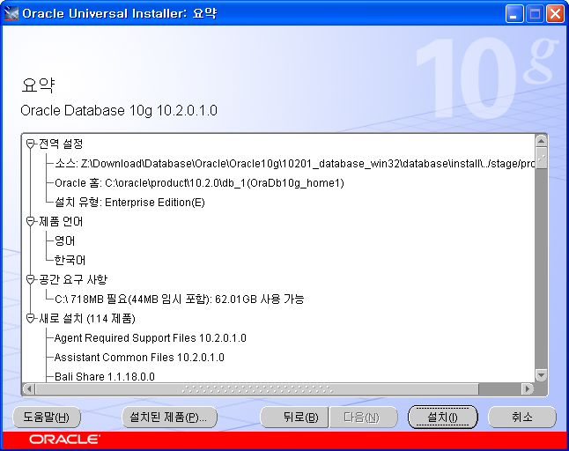
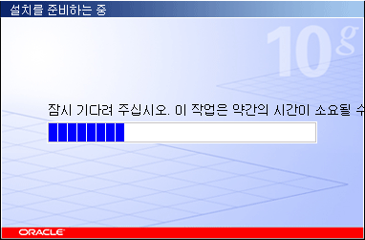
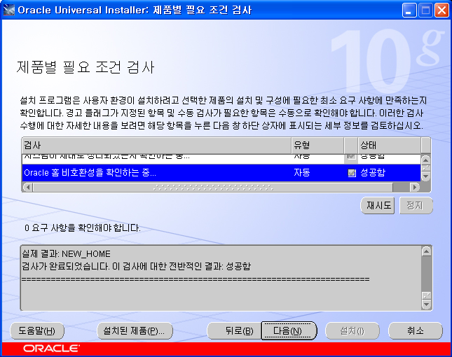
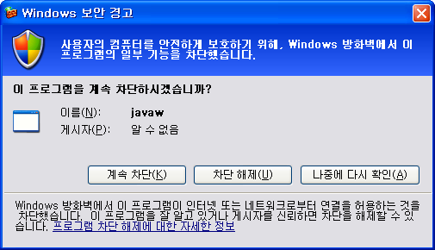
Oracle
Install
Allow Firewall

Slide 4
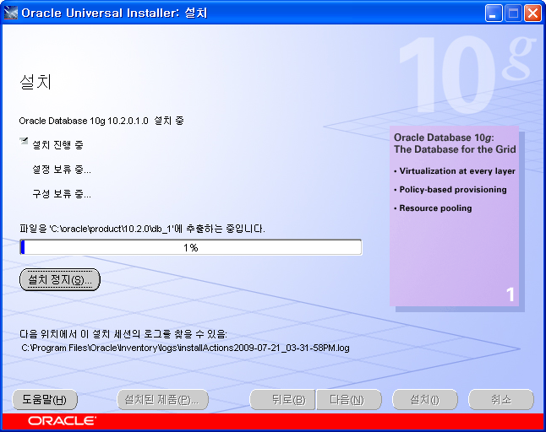
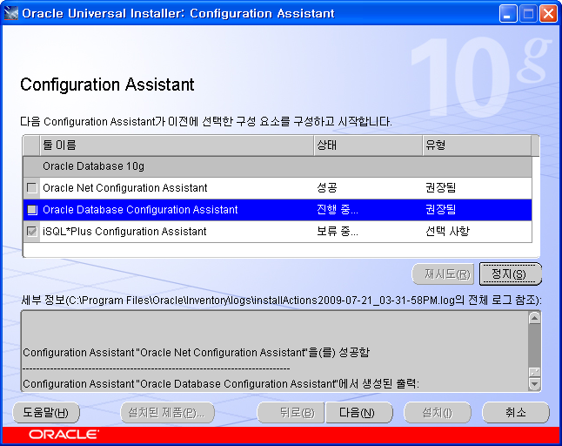
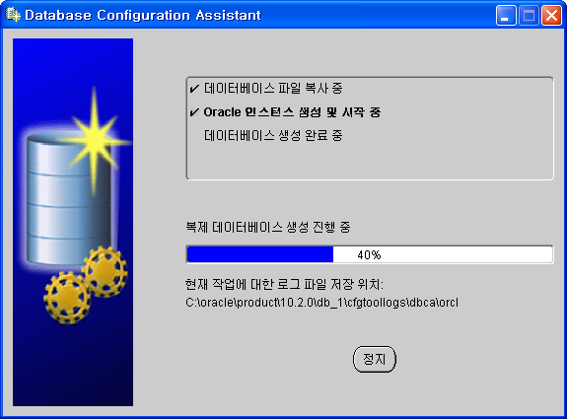
Oracle
Install

Slide 5
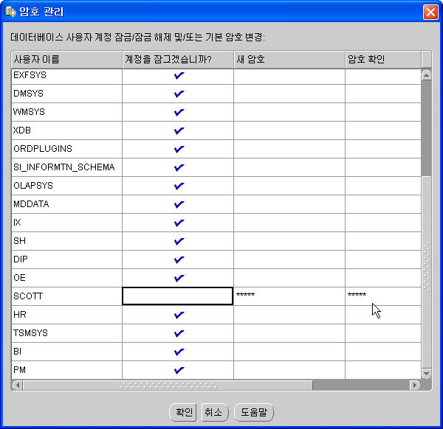
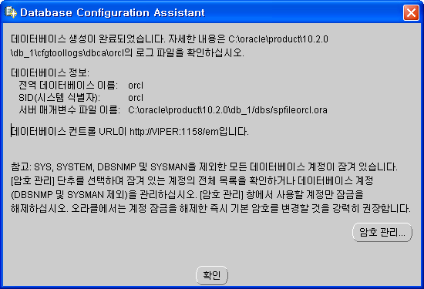
Oracle
Install
Password Management
Unlock User
User: SCOTT
Password: TIGER

Slide 6
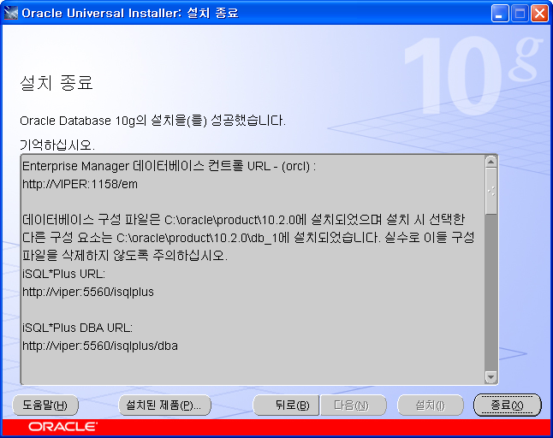
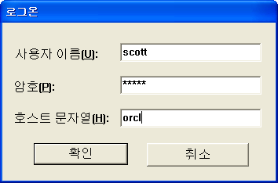
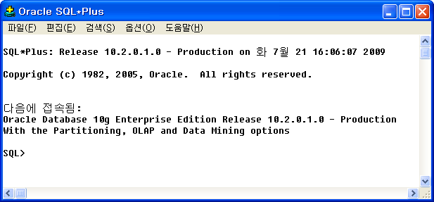
Oracle
Logon

